Slide 1
Inovace výrobků BoschRexroth v roce 2013 – 2014
Bosch Rexroth. The Drive & Control Company
2013-07-04 | DC-IA/MKT21 S.Nätscher | © Bosch Rexroth AG 2013. All rights reserved, also regarding any disposal, exploitation, reproduction, editing, distribution, as well as in the event of applications for industrial property rights.

Slide 2
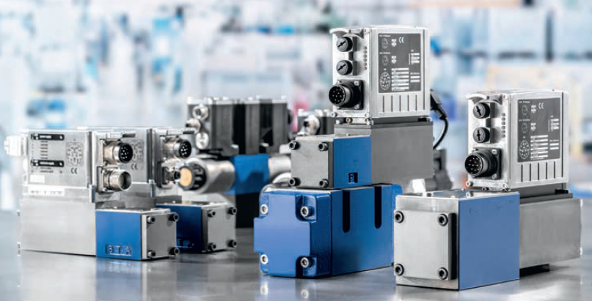
Innovations 2013-2014
Hydraulické ventily IAC -
ventily s integrovaným regulátorem pro řízení hydraulické osy
2013-07-04 | DC-IA/MKT21 S.Nätscher | © Bosch Rexroth AG 2013. All rights reserved, also regarding any disposal, exploitation, reproduction, editing, distribution, as well as in the event of applications for industrial property rights.

Slide 3
Innovations 2013-2014
Hydraulické ventily IAC
Hlavní technické parametry:
-přímo řízené high-response ventily
-velikosti NG 6 a 10
-maximální tlak 315 bar
-maximální průtok 100 l/min
-integrovaný programovatelný digitální regulátor pro řízení osy
-rozhraní(sercos, EtherCAT, EtherNET/IP, PROFINET RT, PROFIBUS)
-připojitelné signály:
4x configurovatelné analogové signály (tlak, síla, teplota…) 10x I/O digitální signály
1x snímač polohy servoválce (SSI, EnDat 2.2 or 1Vss)
-předpřipravené PID regulátory polohy, síly, tlaku, polohy a síly
-integrované bezpečnostní funkce(až do kategorie 4/PL podle EN13849-1)
-regulační smyčka s rychlostí 1ms
2013-07-04 | DC-IA/MKT21 S.Nätscher | © Bosch Rexroth AG 2013. All rights reserved, also regarding any disposal, exploitation, reproduction, editing, distribution, as well as in the event of applications for industrial property rights.

Slide 4
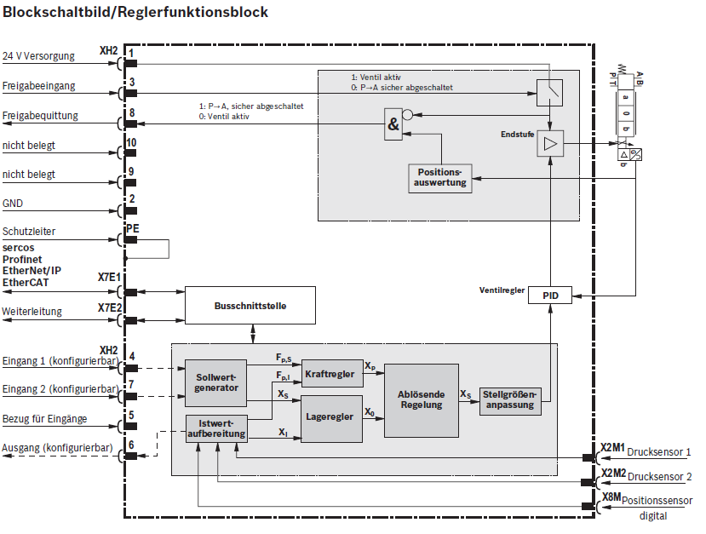
Innovations 2013-2014
Hydraulické ventily IAC
2013-07-04 | DC-IA/MKT21 S.Nätscher | © Bosch Rexroth AG 2013. All rights reserved, also regarding any disposal, exploitation, reproduction, editing, distribution, as well as in the event of applications for industrial property rights.

Slide 5
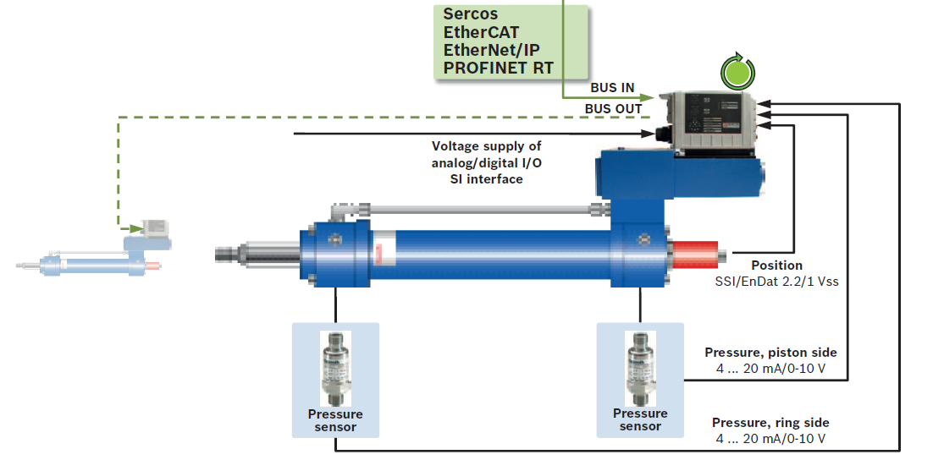
Innovations 2013-2014
Typické zapojení ventilu IAC
2013-07-04 | DC-IA/MKT21 S.Nätscher | © Bosch Rexroth AG 2013. All rights reserved, also regarding any disposal, exploitation, reproduction, editing, distribution, as well as in the event of applications for industrial property rights.

Slide 6
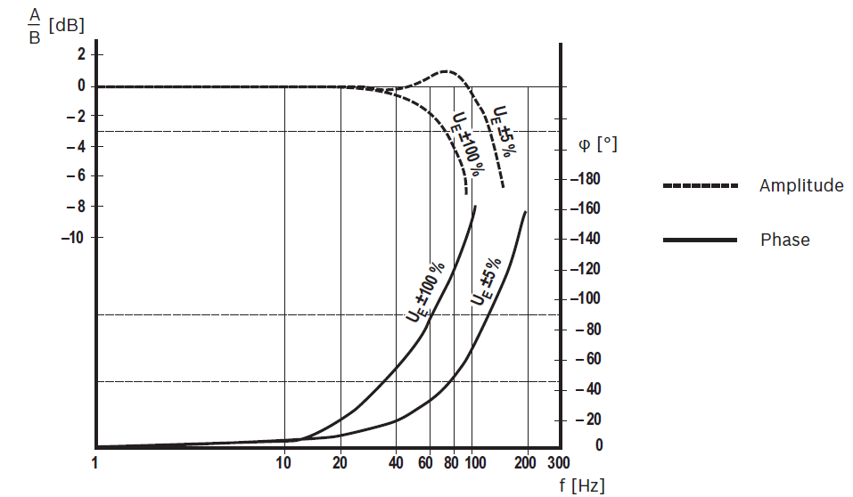
Innovations 2013-2014
Frekvenční charakteristika IAC ventilu NG6 - 30 l/min
2013-07-04 | DC-IA/MKT21 S.Nätscher | © Bosch Rexroth AG 2013. All rights reserved, also regarding any disposal, exploitation, reproduction, editing, distribution, as well as in the event of applications for industrial property rights.

Slide 7
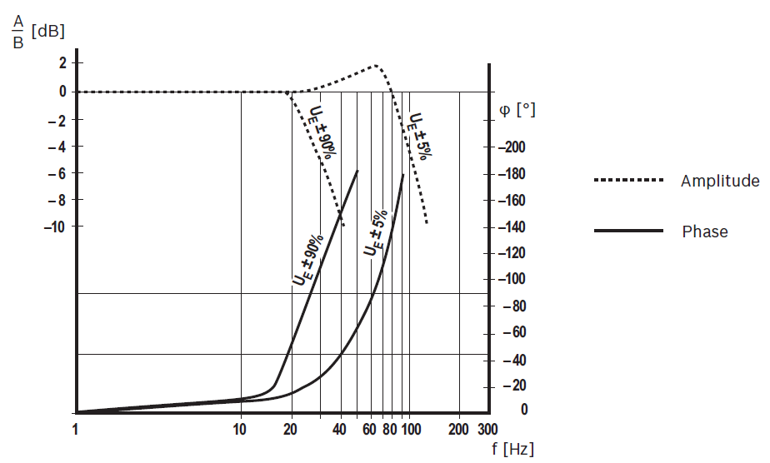
Innovations 2013-2014
Frekvenční charakteristika IAC ventilu NG10 – 90l/min
2013-07-04 | DC-IA/MKT21 S.Nätscher | © Bosch Rexroth AG 2013. All rights reserved, also regarding any disposal, exploitation, reproduction, editing, distribution, as well as in the event of applications for industrial property rights.

Slide 8
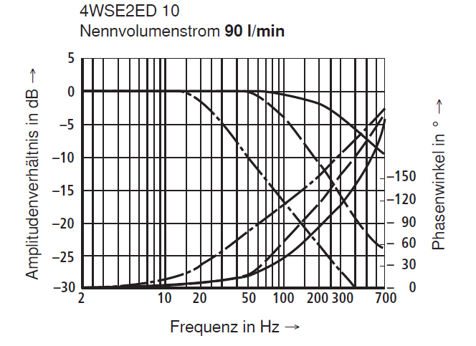
Innovations 2013-2014
Frekvenční charakteristika servoventilu s integrovanou elektronikou NG10 – 90l/min
2013-07-04 | DC-IA/MKT21 S.Nätscher | © Bosch Rexroth AG 2013. All rights reserved, also regarding any disposal, exploitation, reproduction, editing, distribution, as well as in the event of applications for industrial property rights.

Slide 9
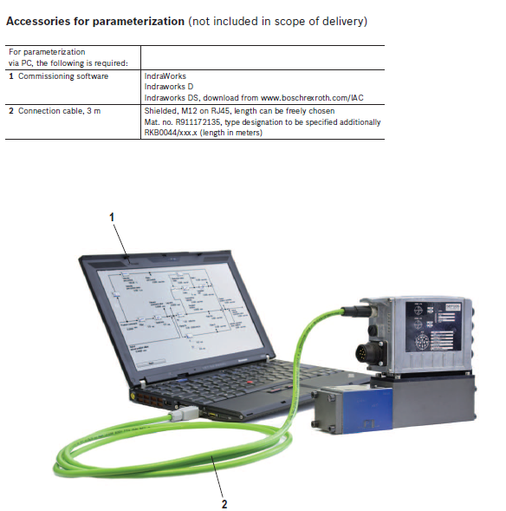
Innovations 2013-2014
Programování a parametrizace IAC ventilů
2013-07-04 | DC-IA/MKT21 S.Nätscher | © Bosch Rexroth AG 2013. All rights reserved, also regarding any disposal, exploitation, reproduction, editing, distribution, as well as in the event of applications for industrial property rights.

Slide 10
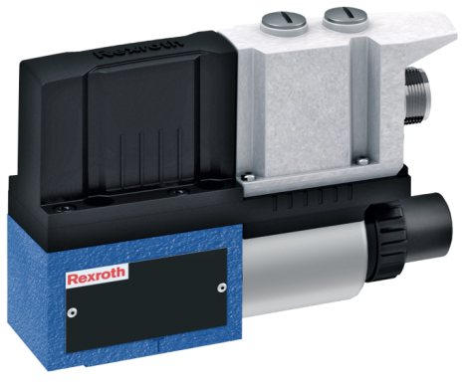
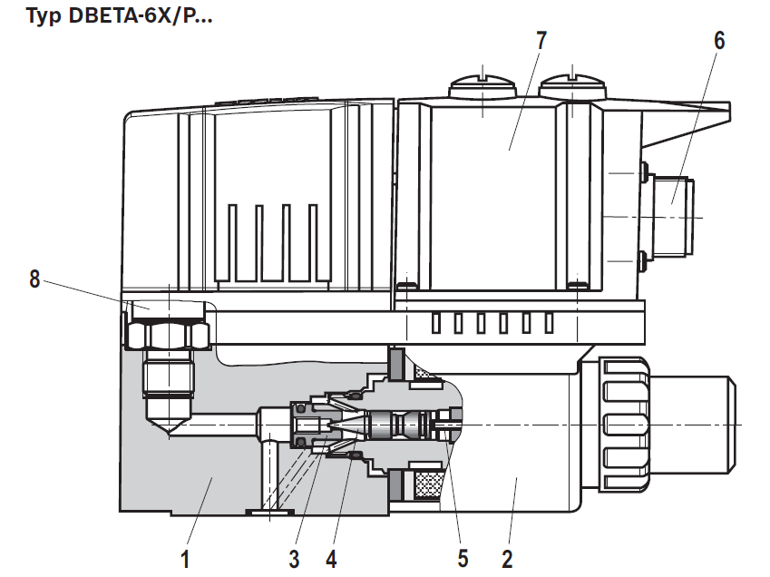
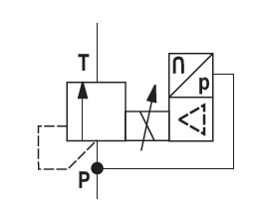
DBETA - tlakový ventil s integrovaným snímačem tlaku
Innovations 2013-2014
Pro aplikace do 500 bar
Jednoduchá aplikace: Integrovaná elektronika s vestavěným snímačem tlaku
Rychlé uvedení do provozu bez potřeby parametrizačního software
2013-07-04 | DC-IA/MKT21 S.Nätscher | © Bosch Rexroth AG 2013. All rights reserved, also regarding any disposal, exploitation, reproduction, editing, distribution, as well as in the event of applications for industrial property rights.

Slide 11
DBETA - tlakový ventil s integrovaným snímačem tlaku a integrovanou elektronikou
Innovations 2013-2014
Hysterese: < 1% z maximálního rozsahu
Citlivost: < 0,25%
Linearita: +/-1%
Rychlost regulace 0-100%, 100%-0 : 165 ms
DBET - tlakový ventil s integrovanou elektronikou
Hysterese: < 4% z maximálního rozsahu
Citlivost: < 0,5%
Linearita: +/-3%
Rychlost reakce 0-100%, 100%-0 : 80 ms
2013-07-04 | DC-IA/MKT21 S.Nätscher | © Bosch Rexroth AG 2013. All rights reserved, also regarding any disposal, exploitation, reproduction, editing, distribution, as well as in the event of applications for industrial property rights.

Slide 12
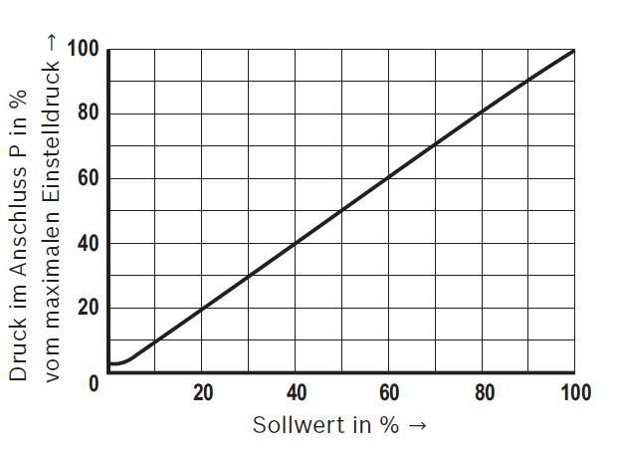
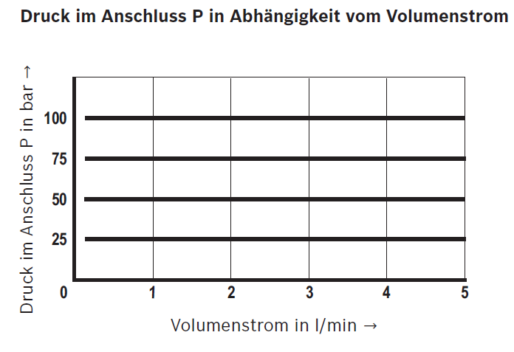
DBETA - tlakový ventil s integrovaným snímačem tlaku a integrovanou elektronikou
Innovations 2013-2014
Jednoduchá aplikace: Integrovaná elektronika s vestavěným snímačem tlaku
Rychlé uvedení do provozu bez potřeby parametrizačního software
2013-07-04 | DC-IA/MKT21 S.Nätscher | © Bosch Rexroth AG 2013. All rights reserved, also regarding any disposal, exploitation, reproduction, editing, distribution, as well as in the event of applications for industrial property rights.

Slide 13
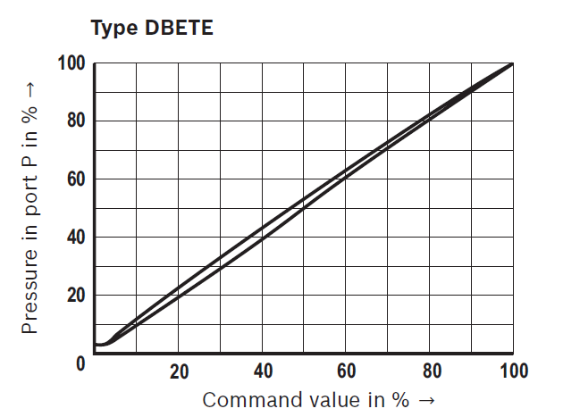
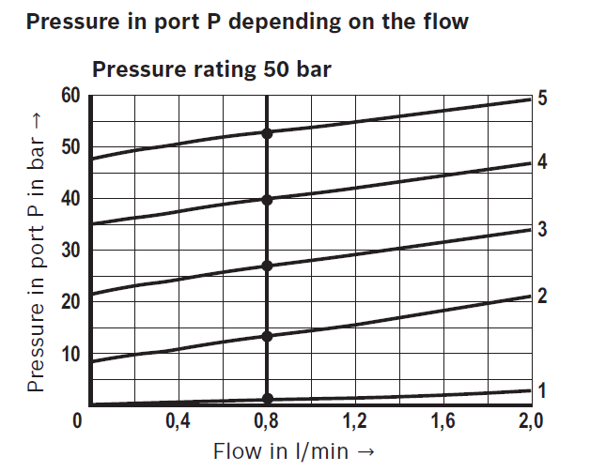
DBET - tlakový ventil s integrovanou elektronikou
Innovations 2013-2014
ff
2013-07-04 | DC-IA/MKT21 S.Nätscher | © Bosch Rexroth AG 2013. All rights reserved, also regarding any disposal, exploitation, reproduction, editing, distribution, as well as in the event of applications for industrial property rights.

Slide 14
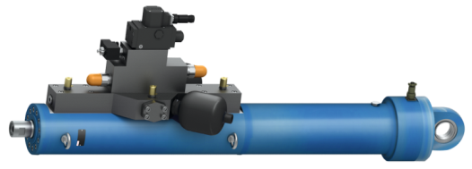
HPC: Rychlý servoválec pro vývojové technologie
Innovations 2013
Ideální pro vysoce dynamické systémy:
-aktivní řízená osa s integrovaným senzorem polohy
Ideální pro frekvence do 50 Hz
Systémy s krátkou dobou dodání – jsou použity modulární předpřipravené části
2013-07-04 | DC-IA/MKT21 S.Nätscher | © Bosch Rexroth AG 2013. All rights reserved, also regarding any disposal, exploitation, reproduction, editing, distribution, as well as in the event of applications for industrial property rights.

Slide 15
Děkuji Vám za pozornost.
Bosch Rexroth. The Drive & Control Company
2013-07-04 | DC-IA/MKT21 S.Nätscher | © Bosch Rexroth AG 2013. All rights reserved, also regarding any disposal, exploitation, reproduction, editing, distribution, as well as in the event of applications for industrial property rights.

